Slide 1
UNIT - IV
Software Testing
Disclaimer:
The lecture notes have been prepared by referring to a book. This document does not claim any originality and cannot be used as a substitute for prescribed textbooks.

Slide 2
List OF Topics
Introduction to Testing
Verification
Validation
Verification Vs Validation
Test Strategy
Planning
Test Project Monitoring and Control
Design of Master Test Plan
Test Case Design
Test Case Management
Test Case Reporting
Test Artifacts

Slide 3
Software testing
Testing is the process of exercising a program with the specific intent of finding errors prior to delivery to the end user.
Basic Definitions
Errors
An error is a mistake, misconception, or misunderstanding on the part of a software developer.
Faults (Defects)
A fault (defect) is introduced into the software as the result of an error. It is an anomaly in the software that may cause it to behave incorrectly, and not according to its specification.
Failures
A failure is the inability of a software system or component to perform its required functions within specified performance requirements [2].

Slide 4
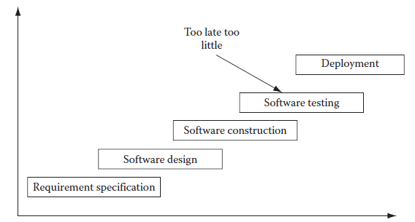
Software Testing
Introduction – Problems with Traditional Development Model
Traditionally, software testing was done only after software was constructed.
This is used to limit the scope of software testing in the development life cycle (see Figure below-Traditional Software Development Model-Too little, Too late testing).
This practice led to a situation that was too little and too late.
By the time software was constructed, already faulty requirement specifications and faulty software design had resulted in defect ridden software.

Slide 5
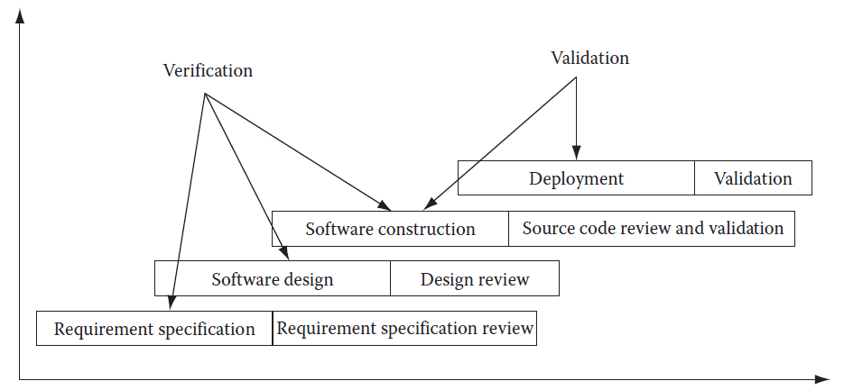
Verification & Validation
Verification and Validation
The source code is reviewed for dead code, unused variables, faulty logic, constructs, etc.
Once the source code is ready to be run as a system, validation testing can be started.

Slide 6
Verification vs validation
Software testing is part of a broader group of activities called verification and validation that are involved in software quality assurance
Verification (Are the algorithms coded correctly?)
The set of activities that ensure that software correctly implements a specific function or algorithm
It refers to the set of tasks that ensure that software correctly implements a specific function
Verification: “Are we building the product right?”
Validation (Does it meet user requirements?)
The set of activities that ensure that the software that has been built is traceable to customer requirements
Validation: “Are we building the right product?”
Verification and validation includes a wide array of SQA activities: technical reviews, quality and configuration audits, performance monitoring, simulation, feasibility study, documentation review, database review, algorithm analysis, development testing, usability testing, qualification testing, acceptance testing, and installation testing

Slide 7
Software testing stratergy – big picture
System Testing
Narrow to
Broader scope
Validation Testing
Integration Testing
Unit Testing
Code
Abstract to
concrete
Design
Requirements
System Engineering

Slide 8
Major Types of testing
Unit testing [white box]
Concentrates on each component/function of the software as implemented in the source code
Integration testing
Focuses on the design and construction of the software architecture
Validation testing
Requirements are validated against the constructed software
System testing
The software and other system elements are tested as a whole
There are other sublevel testing are performed like
Functional Testing (after Unit testing) – Testing technique used – Black box
Regression Testing
Smoke Testing (will see in detail in later slides)

Slide 9
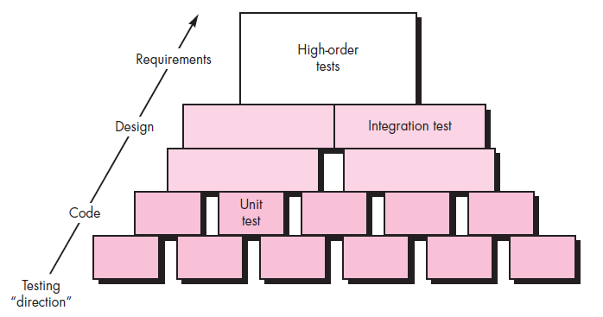
Software testing steps

Slide 10
Testing strategy applied to conventional applications
Unit testing
Exercises specific paths in a component's control structure to ensure complete coverage and maximum error detection
Components are then assembled and integrated
Integration testing
Focuses on inputs and outputs, and how well the components fit together and work together
Validation testing
Provides final assurance that the software meets all functional, behavioral, and performance requirements
System testing
Verifies that all system elements (software, hardware, people, databases) mesh properly and that overall system function and performance is achieved

Slide 11
SOME common error – unit testing
Misunderstood or incorrect arithmetic precedence
Mixed mode operations (e.g., int, float, char)
Incorrect initialization of values
Precision inaccuracy and round-off errors
Incorrect symbolic representation of an expression (int vs. float)
Failure to exit when divergent iteration is encountered
Improperly modified loop variables
Boundary value violations

Slide 12
Integration testing
Defined as a systematic technique for constructing the software architecture
At the same time integration is occurring, conduct tests to uncover errors associated with interfaces
Objective is to take unit tested modules and build a program structure based on the prescribed design
Two Approaches
Non-incremental Integration Testing
Incremental Integration Testing

Slide 13
Non-incremental testing
Commonly called the “Big Bang” approach
All components are combined in advance
The entire program is tested as a whole
Chaos results
Many seemingly-unrelated errors are encountered
Correction is difficult because isolation of causes is complicated
Once a set of errors are corrected, more errors occur, and testing appears to enter an endless loop

Slide 14
Incremental testing
Three kinds
Top-down integration
Bottom-up integration
Sandwich integration
The program is constructed and tested in small increments
Errors are easier to isolate and correct
Interfaces are more likely to be tested completely
A systematic test approach is applied

Slide 15
Top-down integration testing
Modules are integrated by moving downward through the control hierarchy, beginning with the main module .
The control program is tested first. Modules are integrated one at a time. Emphasize on interface testing
Subordinate modules are incorporated in either a depth-first or breadth-first fashion
DF: All modules on a major control path are integrated
BF: All modules directly subordinate at each level are integrated

Slide 16
TOP DOWN integration
Advantages
This approach verifies major control or decision points early in the test process
No test drivers needed
Interface errors are discovered early
Modular features aid debugging
Disadvantages
Stubs need to be created to substitute for modules
that have not been built or tested yet; this code is later discarded.
Because stubs are used to replace lower level modules,
no significant data flow can occur until much later in the
integration/testing process.

Slide 17
Bottom-up integration
Integration and testing starts with the most atomic modules in the control hierarchy
Allow early testing aimed at proving feasibility and emphasize on module functionality and performance

Slide 18
Bottom –up integration
Advantages
This approach verifies low-level data processing early in the testing process
Need for stubs is eliminated
Disadvantages
Driver modules need to be built to test the lower-level modules; this code is later discarded or expanded into a full-featured version
Drivers inherently do not contain the complete algorithms that will eventually use the services of the lower-level modules; consequently, testing may be incomplete or more testing may be needed later when the upper level modules are available

Slide 19
Regression testing
Each new addition or change to baselined software may cause problems with functions that previously worked flawlessly
Regression testing re-executes a small subset of tests that have already been conducted
Regression test suite contains three different classes of test cases
Regression Testing helps to ensure that changes do not introduce unintended behavior or additional errors

Slide 20
Acceptance testing-Alpha and beta testing
Alpha testing
Conducted at the developer’s site by end users
Software is used in a natural setting with developers watching intently
Testing is conducted in a controlled environment
Beta testing
Conducted at end-user sites
Developer is generally not present
It serves as a live application of the software in an environment that cannot be controlled by the developer
The end-user records all problems that are encountered and reports these to the developers at regular intervals
After beta testing is complete, software engineers make software modifications and prepare for release of the software product to the entire customer base

Slide 21
Acceptance testing
A variation on beta testing, called customer acceptance testing, is sometimes performed when custom software is delivered to a customer under contract.
The customer performs a series of specific tests in an attempt to uncover errors beforeaccepting the software from the developer.
In some cases (e.g., a major corporate orgovernmental system) acceptance testing can be very formal and encompass many days or even weeks of testing.

Slide 22
System testing
Recovery Testing
Security Testing
Stress Testing
Performance Testing
Deployment Testing

Slide 23
Test Strategy and Planning
Introduction
Software testing is a vast field in itself, and so the common practice is to consider it as a separate project.
In those cases, it is known as an independent verification and validation project.
As such, a separate project plan is made for that project and is linked to the parent software development project.
There are many techniques available to execute software test projects.
It depends on the kind of test project. However, most test projects must have a test plan and a test strategy before the project can be ready for execution.
Often due to time constraints, testing cycles are cut short by project managers.
This leads to a half-tested product that is pushed out of the door.
In such cases, a large number of product defects are left undetected.
Ultimately, end users discover these defects. Fixing these defects at this stage is costly.
Moreover, they cannot be fixed one at a time.
They are to be taken in batches and are incorporated in maintenance project plans.
This leads to excessive costs in maintaining the software.

Slide 24
Test Strategy and Planning
It is a lot cheaper to trap those bugs during the testing cycle and fix them.
It is appropriately said that “testing costs money but not testing, costs more!”
Test strategies should include things like test prioritization, automation strategy, risk analysis, etc.
Test planning should include a work breakdown structure, requirement review, resource allocation, effort estimation, tools selection, setting up communication channels, etc.
Test Prioritization
Even before the test effort actually starts, it is of utmost importance that the test prioritization should be made.
First of all, all parts of the software product will not be used by end users with the same intensity.
Some parts of the product are used by end users extensively, while other parts are seldom used.
So the extensively used parts of the product should not have any defects at all and thus they need to be tested thoroughly.

Slide 25
Test Case
A test case in a practical sense is a test-related item which contains the following
information:
1. A set of test inputs. These are data items received from an external source by
the code under test. The external source can be hardware, software, or human.
2. Execution conditions. These are conditions required for running the test, for
example, a certain state of a database, or a configuration of a hardware device.
3. Expected outputs. These are the specified results to be produced by the code
under test.
Test
A test is a group of related test cases, or a group of related test cases and test procedures
Test Bed
A test bed is an environment that contains all the hardware and software needed to test a software component or a software system.

Slide 26
How to Write Test Cases: Sample Template with Examples
A Test Case is a set of actions executed to verify a particular feature or functionality of your software application. A Test Case contains test steps, test data, precondition, postcondition developed for specific test scenario to verify any requirement. The test case includes specific variables or conditions, using which a testing engineer can compare expected and actual results to determine whether a software product is functioning as per the requirements of the customer.

Slide 27
Test Scenario Vs Test Case
Test scenarios are rather vague and cover a wide range of possibilities. Testing is all about being very specific.
For a Test Scenario: Check Login Functionality there many possible test cases are:
Test Case 1: Check results on entering valid User Id & Password
Test Case 2: Check results on entering Invalid User ID & Password
Test Case 3: Check response when a User ID is Empty & Login Button is pressed, and many more

Slide 28
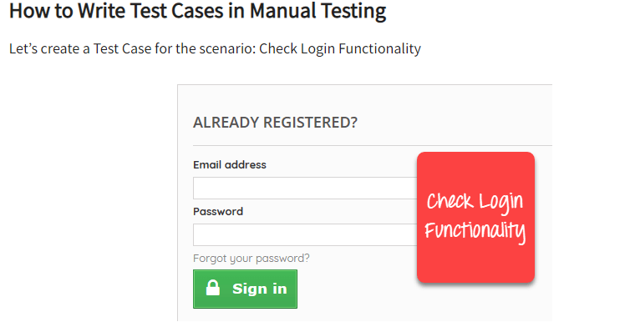

Slide 29
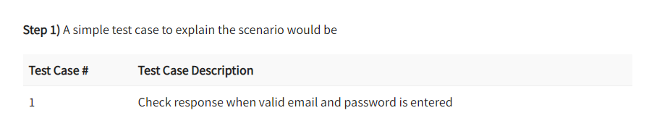

Slide 30
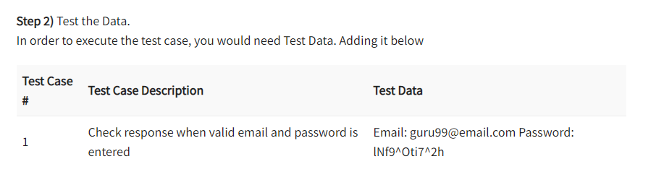

Slide 31
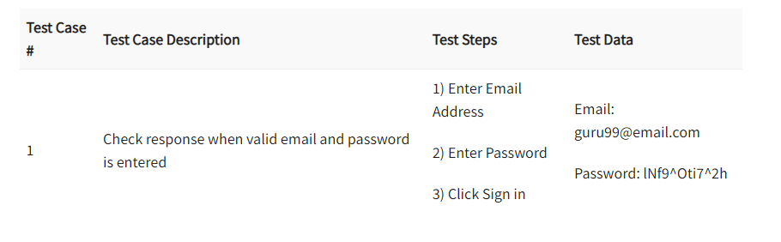

Slide 32
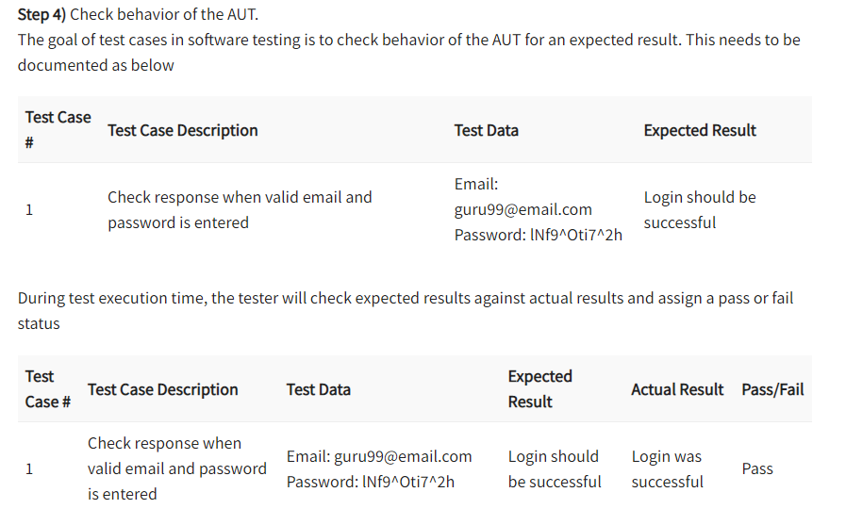

Slide 33
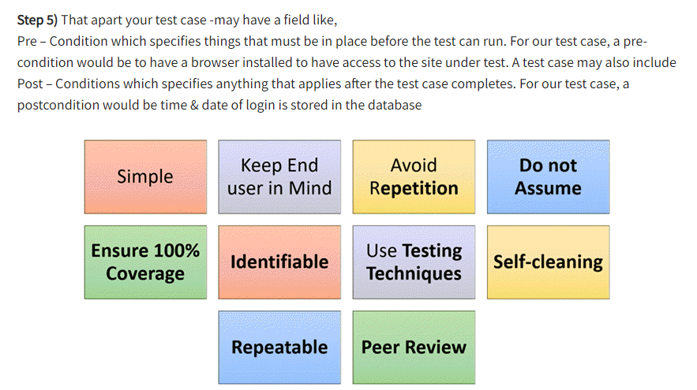

Slide 34
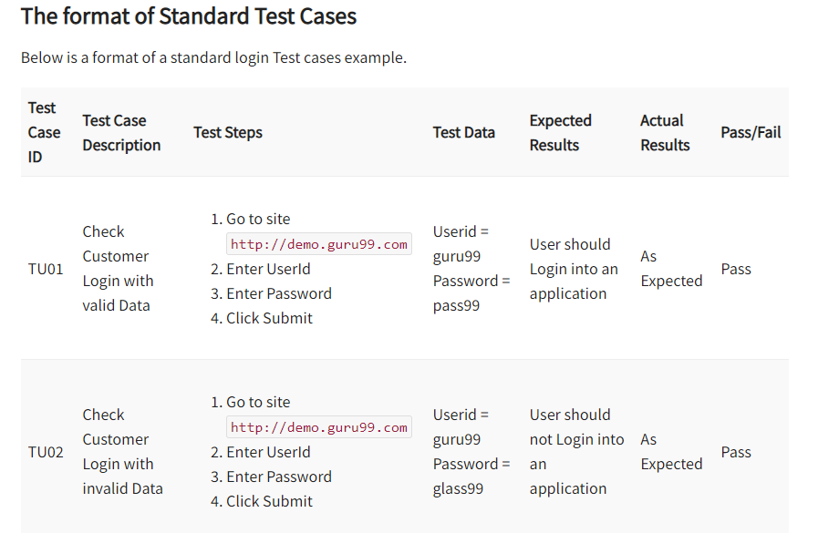

Slide 35
Test cases have a few integral parts that should always be present in fields. However, every test case can be broken down into 8 basic steps.
Step 1: Test Case ID
Test cases should all bear unique IDs to represent them. In most cases, following a convention for this naming ID helps with organization, clarity, and understanding.
Step 2: Test Description
This description should detail what unit, feature, or function is being tested or what is being verified.
Step 3: Assumptions and Pre-Conditions
This entails any conditions to be met before test case execution. One example would be requiring a valid Outlook account for a login.
Step 4: Test Data
This relates to the variables and their values in the test case. In the example of an email login, it would be the username and password for the account.
Step 5: Steps to be Executed
These should be easily repeatable steps as executed from the end user’s perspective. For instance, a test case for logging into an email server might include these steps:
Open email server web page.
Enter username.
Enter password.
Click “Enter” or “Login” button.
Step 6: Expected Result
This indicates the result expected after the test case step execution. Upon entering the right login information, the expected result would be a successful login.
Step 7: Actual Result and Post-Conditions
As compared to the expected result, we can determine the status of the test case. In the case of the email login, the user would either be successfully logged in or not. The post-condition is what happens as a result of the step execution such as being redirected to the email inbox.
Step 8: Pass/Fail
Determining the pass/fail status depends on how the expected result and the actual result compare to each other.
Same result = Pass Different results = Fail

Slide 36
Test Strategy and Planning
Test Prioritization
For making such a strategy, you must prioritize your testing.
Put a high priority on tests which are to be done for these critical parts of the software product and put a low priority on uncritical parts.
Then test the high priority areas first.
Once testing is thoroughly done for these parts, then you should start testing the low priority areas.
Risk Management
The test manager should also do plan for all known risks that could impact the test project.
If proper risk mitigation planning is not done and a mishap occurs, then the test project schedule could be jeopardized, costs could escalate and/or quality could go down.
Some of the risks that can have severe, adverse impact on a test project include an unrealistic schedule, resource unavailability, skill unavailability, frequent requirement changes, etc.

Slide 37
Test Strategy and Planning
Risk Management
Requirement changes pose a serious threat to testing effort because for each requirement change, the whole test plan gets changed.
The test team has to revise its schedule for additional work as well as to assess impact of the change on the test cases they have to recreate.
Some enthusiastic test engineers estimate much less effort than it actually should be.
In that case, the test manager would be in trouble trying to explain why testing is taking more than the scheduled time schedule.
In such cases, even after loading testing engineers more than 150%, the testing cycle get delayed.
This is a very common situation on most of the test projects.
This also happens because the marketing team agrees on unrealistic schedules with the customer in order to bag the project.
Even the test manager at that time feels that somehow he will manage it, but later on it proves impossible to achieve.
Other test engineers unnecessarily pad their estimate and later on, when the customer detects it, the test manager finds himself in a spot.

Slide 38
Test Strategy and Planning
Risk Management
When the software development market, along with the software testing market, is hot (this is the case most of the time, as businesses need to implement software systems more and more and so software professionals are in great demand), software professionals have many job offers in hand.
They leave the project at short notice and the test manager has to find a replacement fast.
Sometimes, a project may have some kind of testing for which skilled test professionals are hard to find.
In both situations, the test manager may not be able to start those tasks in need of adequate resources.
For test professional resources, a good alternative resource planning is required.
The test manager should be in consultation with human resource manager, keep a line of test professionals who may join in case one is needed on his project.
For scheduling problems, the test manager has to ensure in advance that schedules do not get affected.
He has to keep a buffer in the schedule for any eventuality.

Slide 39
Test Strategy and Planning
Risk Management
To keep a tab on the project budget, the test manager has to ensure that the schedule is not unrealistic and also has to load his test engineers appropriately.
If some test engineers are not loaded adequately, then project costs may go higher.
For this reason, if any test professionals do not have enough assignments on one project, they should be assigned work from other projects.
Effort Estimation
For making scheduling, resource planning and budget for a test project, the test manager should make a good effort estimate.
Effort estimate should include information such as project size, productivity, and test strategy.
While project size and test strategy information comes after consultation with the customer, the productivity figure comes from experience and knowledge of the team members of the project team.
The wideband Delphi technique uses brainstorming sessions to arrive at effort estimate figures after discussing the project details with the project team.

Slide 40
Test Strategy and Planning
Effort Estimation
This is a good technique because the people who will be assigned the project work will know their own productivity levels and can figure out the size of their assigned project tasks from their own experience.
Initial estimates from each team member are then discussed with other team members in an open environment.
Each person has his own estimate.
These estimates are then unanimously condensed into final estimate figures for each project task.
In an experience-based technique, instead of group sessions, the test manager meets each team member and asks him his estimate for the project work he has been assigned.
This technique works best when team members are well aware, particularly, of their prior experience of similar project tasks.
Effort estimation is one area where no test manager can have a good grasp at the initial stages of the project.
This is because not many details are clear about the project.
As the project unfolds, after executing some of its related tasks, things become clearer.

Slide 41
Test Strategy and Planning
Effort Estimation
At that stage, any test manager can comfortably give an effort estimate for the remaining project tasks. But that is too late.
Project stakeholders want to know at the very beginning of the project, what would be the cost estimates and when the project would be delivered.
These two questions are very important for project stakeholders and it is on the top of their mind.
Unfortunately, test managers are not equipped to provide an accurate schedule and costs for the project at those initial stages because of unclear project scope, size, etc.
Nevertheless, it is one of their critical tasks that they have to finish and provide the requested information.
The best solution is to find a relatively objective method of effort estimation and provide the requested information.

Slide 42
Test Strategy and Planning
Effort Estimation: Test Point Analysis
There are many methods available for effort estimation for test projects.
Some of them include test point analysis, the wideband Delphi technique, experience-based estimation, etc.
In the test point analysis technique, three inputs required are project size, test strategy, and productivity.
Project size is determined by calculating the number of test points in the software application which is being developed.
Test points, in turn, are calculated from function points.
The number of function points is calculated from the number of functions and function complexity.
If the number of function points in the application has been calculated by the development team, then test points are calculated from the available function point information.
Otherwise rough function point data can be used (Figure below - Test point analysis components).
A test strategy is derived from two pieces of information from the customer, what will be the quality level for the application and which features of the application will be used most frequently.

Slide 43
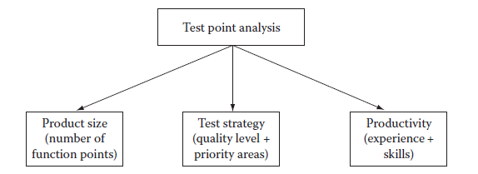
Test Strategy and Planning
Effort Estimation: Test Point Analysis
Productivity is derived from knowledge and experience of the test team members.
While productivity can be calculated objectively without taking reference from any statistical data, it makes sense to use past productivity data from previously executed projects to make productivity figures more realistic.
In case of iterative development, testing cycles will be short and iterative in nature.
The test manager should make the test effort calculations accordingly.

Slide 44
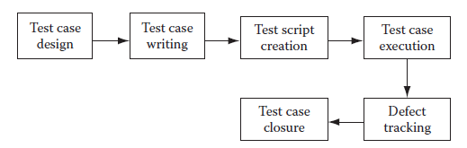
Test Project Monitoring and Control
Introduction
Test projects involve a large variety of activities including test case design, test case management, test case automation, test execution, defect tracking, verifying and validating the application under test, etc (Figure below – Test life cycle).
Test Case Design
A proper test case design plan goes a long way in ensuring that test cases are designed properly.
The test manager has to ensure which kind of tests are to be designed, how many test cases have to be written for particular modules and which test areas are priority areas.

Slide 45
Test Project Monitoring and Control
Test Case Design: Test Types
An application may have to be tested for functionality, performance, usability, compatibility and many other kinds of things to make sure it is really useful for end users.
For each kind of testing, a set of test cases has to be written and executed then finally, the system should be verified and validated.
For applications that have many versions, regression tests also have to be performed.
Managing all these kinds of testing is a big task for the test manager.
A good test manager will first divide the testing tasks on the basis of test types.
Then tasks can be further divided by modules.
After that, he can allocate testing tasks to test engineers appropriately.
There is one more way of segregating tests.
Depending on the project phase, we need to perform system testing, integration testing or user acceptance testing.
Usually when the application is built after the construction phase, it has to be tested and verified whether it is functioning as per requirements.

Slide 46
Test Project Monitoring and Control
Test Case Design: Test Types
Integration testing is performed when the application needs to be integrated with any other external application to ensure that integration is proper.
User acceptance testing is done by end users.
If any defect is found during these tests, they are fixed so that the application goes into production with as few defects as possible.
Test Case Management
There could be existing test cases as well as new test cases that also need to be created.
Test case management involves managing different versions of test cases, keeping track of changes in them, keeping a separate repository of test cases based on type of tests, as well as creating and managing automation scripts.

Slide 47
Test Project Monitoring and Control
Test Bed Preparation
Test bed preparation involves installing the application on a machine that is accessible to all test teams.
Care is taken to ensure that this machine is free of any interference from unauthorized access.
Test data is populated in the application.
Care should also be taken to ensure that the test bed resembles the production environment as closely as possible, including all software and hardware configurations.
For all types of testing, it is very important that the “application under test” (UAT) should be tested under an environment that is as close to the environment under which the proposed application will be deployed for production.
That is why test bed preparation is very important.
The application should be installed on a dedicated server that has the same configuration as the proposed production environment.
This server should not be used for any other purpose except for testing.

Slide 48
Test Project Monitoring and Control
Test Bed Preparation
It should be installed centrally, so that even distributed teams, contractors or service providers can easily access it using remote desktop sharing or any peer to peer networking protocol over the Internet.
If the application can be directly accessed over the Internet then it is even better.
There should not be any testing done on applications that are deployed on the local test engineer’s machine.
To gain familiarity with the application and preliminary testing, it is acceptable to have a local copy of the application, but never for testing when defects are to be logged and verified by many people.
It is because it is very important to reproduce the defect when the developer or any concerned person asks for it.
In case of disputes, if a defect cannot be reproduced, then it becomes difficult for the test team to justify why a defect has been logged when others cannot reproduce it.
That is the reason for which the test bed should be prepared very carefully and kept as isolated from any other environment as much as possible to preserve its integrity.

Slide 49
Test Project Monitoring and Control
Test Bed Preparation
The test data preparation is also a very tricky affair.
The test data should closely resemble what the end users use in their daily transactions.
For this, the test team can get some business data already used by the end users.
The test bed should be populated with a similar kind of data.
Test Case Execution
Test case execution involves executing prepared test cases manually or using automation tools to execute them.
For regression tests, automated test execution is a preferred method.
After each test case is executed, it may pass or fail.
If it fails then defects have to be logged.
Exit criteria for test case execution cycle are generally defined in advance.
Generally, when a certain level of quality of the application is reached then test execution stops.

Slide 50
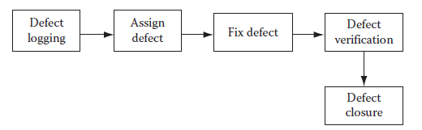
Test Project Monitoring and Control
Defect Tracking
Defect tracking is one of the most important activities in a test project.
During defect tracking it is ensured that defects are logged and get fixed.
All defects and their fixing are tracked carefully (Figure below – Defect life cycle).
Defect count per hour per day is a common way of measuring performance of a test team.
If the testing is done for an in-house software product, traditionally, it is used to, not be a performance evaluation measurement.
What really counted was the number of defects found in production when the software product was deployed and used by end users.
But it is too late for a performance measurement.

Slide 51
Test Project Monitoring and Control
Defect Tracking
What if many of the test team members left before the product was deployed?
In fact this is a reality, given the high attrition rate (as much as 20% at many corporations) of software professionals.
Once they are gone, there is no point in measuring the performance.
Thus, a better measurement would allow for more immediate results.
This is achieved by measuring the defect count per hour per day.
Then there is the case of outsourced test projects.
If the contract is only for testing up to deployment and not afterward, then measurement does not make sense after the contract has ended.
A good defect tracking application should be deployed on a central server that is accessible to all test and development teams.
Each defect should be logged in such a way that it could be understood by both development and testing teams.
Generally, the defects should be reproducible, but in many instances, this is difficult.
In such instances, a good resolution should be made by the test and development managers.

Slide 52
Test Case Reporting
Test Case Reporting
During the execution of a test project, many initial and final reports are made.
But status reports also need to be made.
Test reports include test planning reports, test strategy reports, requirement document review comments, number of test cases created, automation scripts created, test execution cycle reports, defect tracking reports, etc.
Some other reports include trace-ability matrix reports, defect density, test execution rate, test creation rate, test automation script writing rate, etc.

Slide 53
REFERENCES
Ashfaque Ahmed, Software Project Management: A Process-driven approach, Boca Raton, Fla: CRC Press, 2012.

Slide 54
THANK YOU

